Slide 1
NLU Continues:
Meeting and Event Planning during COVID-19

Slide 2
Presenter INFORMATION
For Facilities and Reservations:
Marty Mickey, mmickey@nl.edu
Karolynn Boness, kboness@nl.edu
For Presence / Eagle Life:
Marquece Holifield, mholifield@nl.edu
Danielle Laban, dlaban@nl.edu
For COVID-19 Response / Emergency information:
Aurélio Valente, avalente@nl.edu

Slide 3
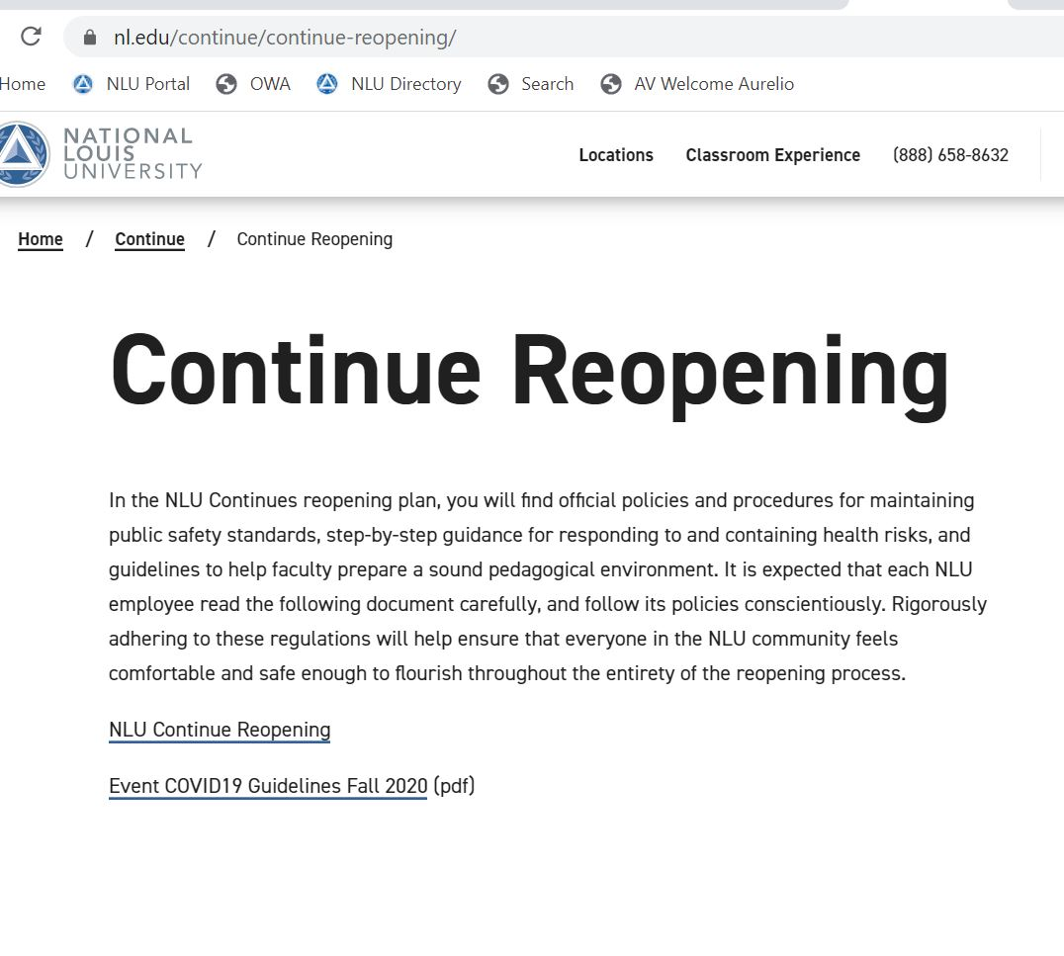
BEFORE WE START …
1. Go to
nl.edu/continue/continue-reopening
2. Download Event Guidelines

Slide 4
Workshop Agenda
Welcome
A fall opening like no other & general public heath guidelines
Meeting and Event Planning Guidelines
  Meeting and Event Planning Packet
  Open vs. Closed Meetings
  12 steps
Reserving Space Online
Using Presence / Eagle Life App to Register event, take RSVPs and attendance
Enhanced Cleaning
Closing Comments, Concerns & Questions

Slide 5



THREE PLANS
IHE Industry Group:
Be Safe Chicago
Safely Launching 2020
Reopening Florida’s Schools

Slide 6

REOPENING GUIDELINES
Healthy Community Interactions
  Social Distancing
  Hygienic Requirements
  Gathering Sizes
  Personal Protective Equipment
  Building Access
Enhanced Cleaning
Screening and Monitoring
Contact Tracing

Slide 7
HOST Responsibilities
NLU encourages virtual gatherings via Zoom and other platforms whenever feasible in order to minimize the risks of COVID-19; however, some in-person indoor and outdoor meetings and events can be planned with a measured and controlled approach.
Individual Responsibility (NLU Eagle Commitment) vs. Host Responsibility
Host Responsibility:
  Create conditions to ensure full compliance with Phase IV guidelines.
  Communicate expectations to participants for healthy community interactions.
  Ensure integrity of Contact Tracing efforts.

Slide 8
MEETING TYPES
Closed Meetings and Events: Meetings and events with a specific invite list. Examples include staff meetings, class meetings, and audience specific event. Invitation list should not exceed 25% of room capacity or 50 individuals (including hosts and planners).
Open Meetings and Events: Meetings without a preset list of attendees. Examples include, but are not limited to, open houses, student events, guest speakers or panel discussions, social events. Open meetings should be planned with more than a month lead-time to allow for the required RSVP process to ensure that attendance does not exceed capacity (25% of room capacity, not to exceed 50 individuals).
SPECIAL NOTE: 50 person capacity includes BOTH event planners and staff AND guests. Example: If there are 15 NLU staff running the event, the max guest count is 35 individuals.

Slide 9

BREAK FOR Questions

Slide 10
12 Steps to Safely planning meetings and Events
Planners should secure appropriate approval from department head before proceeding with planning.
Planners should be aware of reduced room capacity when requesting room or facility. Online Request: https://app.smartsheet.com/b/form/f8e3db7d37d34a15949e46c14f8ba449
Once room or facility is confirmed, planners should create an event in Presence/Eagle Life App for the purposes of attendance and, if needed, for advance participant registrations.
If the meeting or event has food, all food and drinks should be individually wrapped (e.g. box lunches or individually wrapped sandwiches). No food is to be served family or buffet style. All drinks should be individual servings, no drink pitchers should be used. Planners should use recyclable and disposable plates, cups, and cutlery.

Slide 11
12 Steps to Safely planning meetings and Events
Open meetings and events require a month lead time to secure a room or facility approval. Same minimum planning time is suggested, but not required, for closed meetings. However, closed meetings will require 48 hours notice for meeting space to be assigned and closed events will require 2 to 3 weeks notice.
Open meetings and events require an RSVP process with total participants set at 25% of original room capacity, but not to exceed 50 individuals including hosts and speakers.
Planners are required to enforce all public health requirements (social distancing, face coverings, and provide hand sanitizers at event). Planners should display CDC signage at event. Print resources can be downloaded at https://www.cdc.gov/coronavirus/2019-ncov/communication/print-resources.html.

Slide 12
12 Steps to Safely planning meetings and Events
Prior to the event, minimally the day before, event registrations should close and event planner should send attendees a confirmation with safety expectations.
To be included in confirmation and sent to guests prior to event, and announced at beginning of event.
Guests must self-screen prior to coming to campus and stay home if showing any COVID-19 related symptoms or signs of sickness.
Do NOT attend event IF you have come in close contact with someone who is a confirmed positive, or myself have been considered a confirmed or presumed positive of COVID-19 in the last 14 days.
Guests must agree to participate in social distancing with other individuals while on any NLU property or NLU function.
Guests must agree to wear personal protective equipment (facemasks, gloves, etc.) as outlined by state and local mandates.
Guests must agree to practice personal hygiene such as frequent handwashing upon arrival, departure and throughout the day, and utilize hand sanitizer as needed in public spaces.
Guests must agree that they will not come to campus if I have traveled outside the United States or to any of the states listed on the CDPH travel ban in the last 14 days. If attending event in Chicago, they agree to abide by Chicago travel advisory.

Slide 13
12 Steps to Safely planning meetings and Events
Prior to the event, planners should manage event ingress to facilitate social distancing especially if check-in is required.
At beginning of event, planners must remind guests of expected behaviors such as social distancing, wearing face coverings and location of rest rooms for personal use (see suggested list).
Attendance of all individuals (including hosts and speakers) at the event must be tracked via Presence/Eagle Life app with a required check in process, to ensure ability to facilitate contact tracing, if necessary.
At closing of event, planners should manage egress to ensure social distancing.

Slide 14
BREAK FOR Questions

Slide 15
RESERVING SPACE
Standard room request requirements remain in effect.
Meeting Request
These are requests for a single room space, using the room as is, no set-up, no catering/food services, no outside service providers, etc.
After obtaining permission from your department head and/or your VP/Dean; complete the on-line Facilities Request form.
Event Request
These are more involved requests that may require multiple rooms, multiple dates, room set-up, catering/food services, media assistance, outside service providers, plans for supervising minors, use of the freight elevator, etc.
Same as a meeting request, you will need to complete the on-line Facilities Request form after obtaining permission from your department head and/or your VP/Dean.
A member of Facilities Management will contact you and send you a Description of Events form and any other necessary forms.
When all forms and possible additional approvals are completed, your reservation will be confirmed.
Please contact Karolynn Boness in Facilities Management at 847/947-5895 or at kboness@nl.edu if you need a more in-depth orientation.
Facilities Request Form Submission is Required: | Closed | Open
Meeting | 2 business Days | 1 month
Event | 2 to 3 Weeks | 1month

Slide 16
BREAK FOR Questions

Slide 17
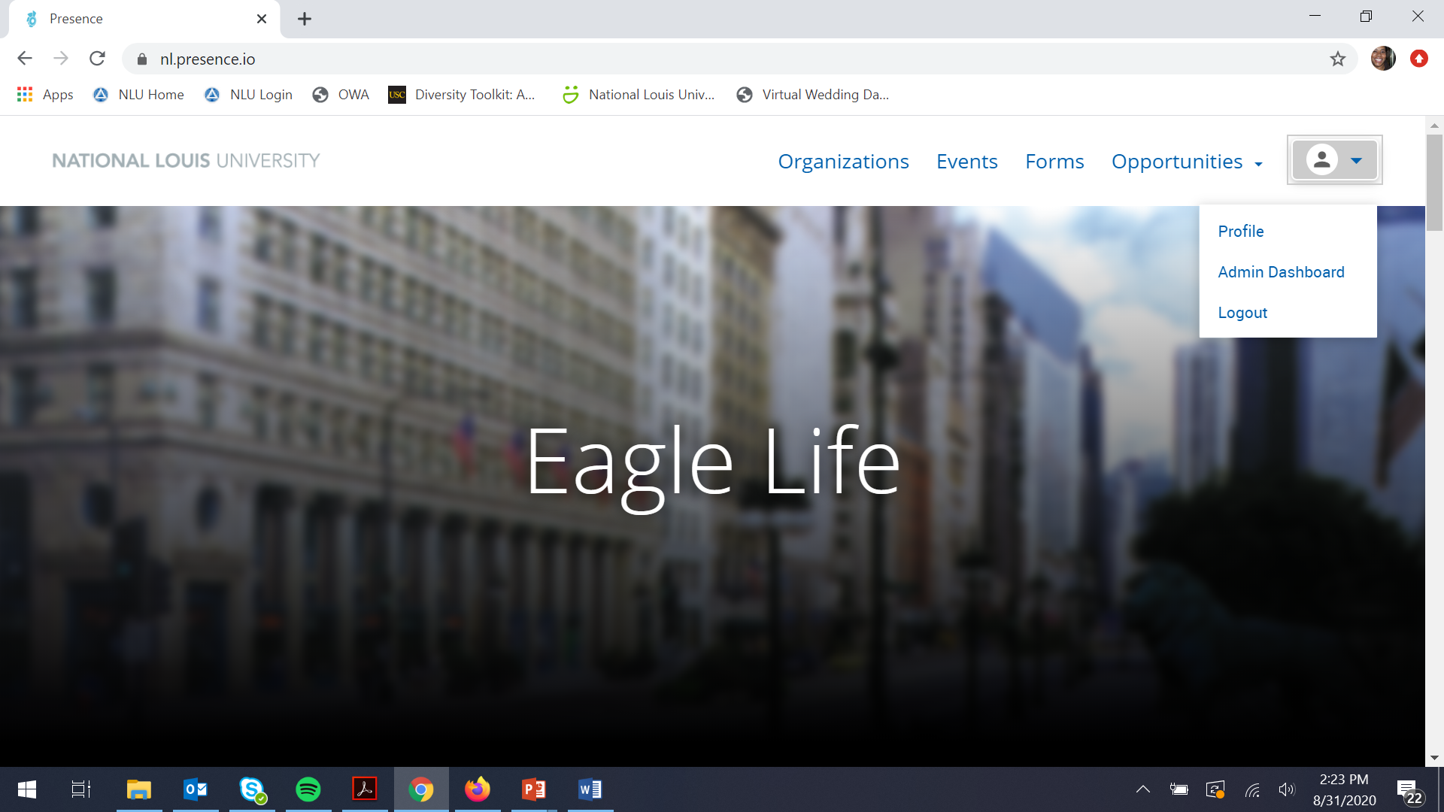
USING PRESENCE / EAGLE LIFE – Creating your EVENT

Slide 18
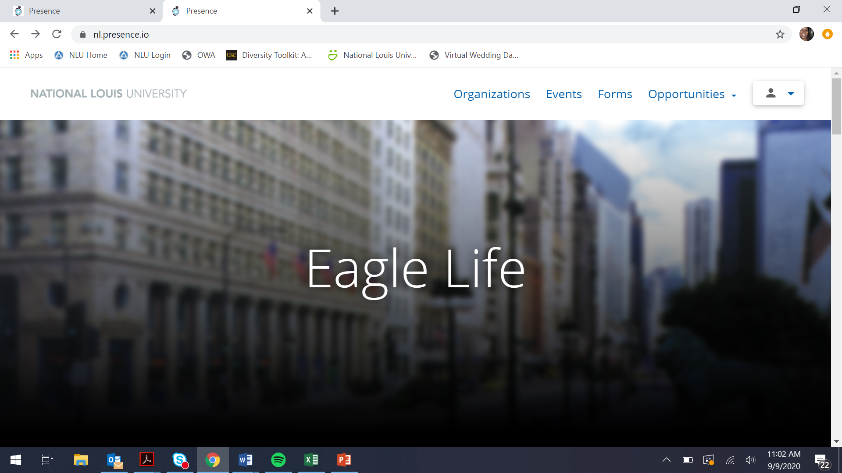
USING PRESENCE / EAGLE LIFE – Creating your EVENT

Slide 19
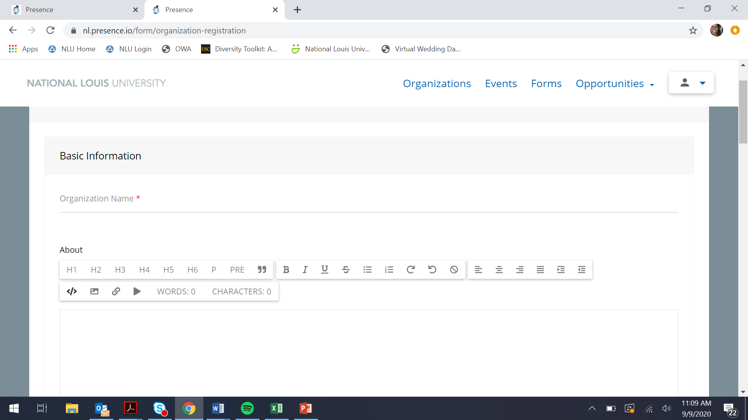
USING PRESENCE / EAGLE LIFE – Creating your EVENT
Select the organization form and select department in the category section of the form

Slide 20
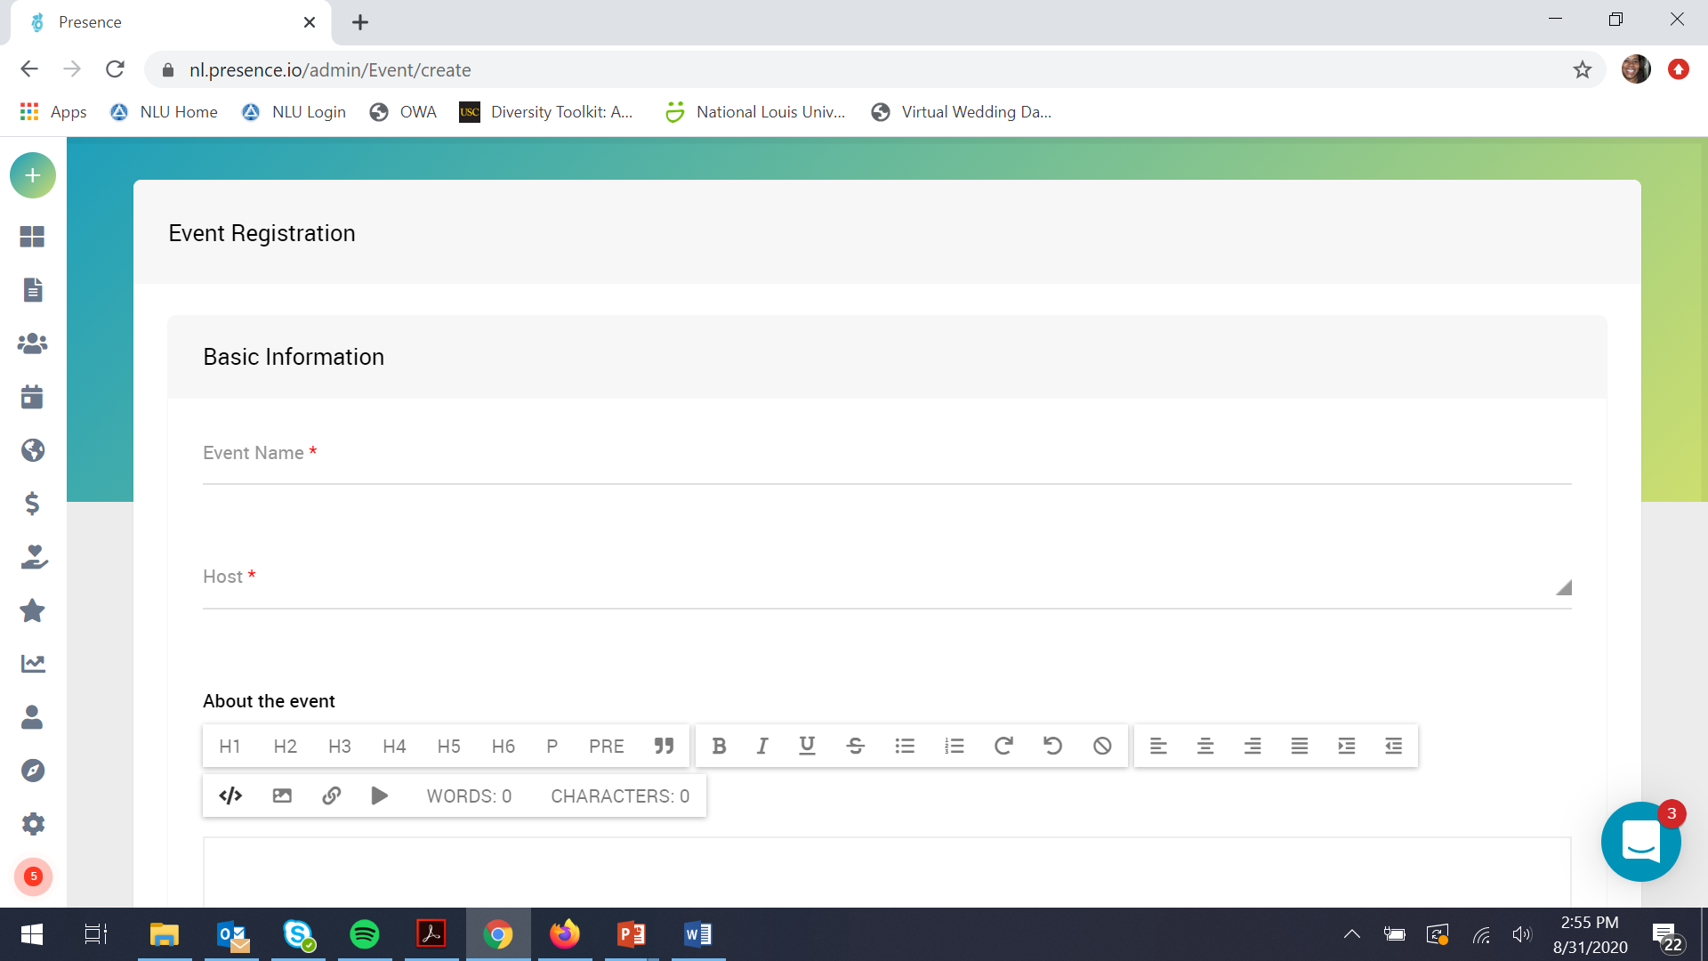
USING PRESENCE / EAGLE LIFE – Creating your EVENT
Click on events and the + to create your event

Slide 21
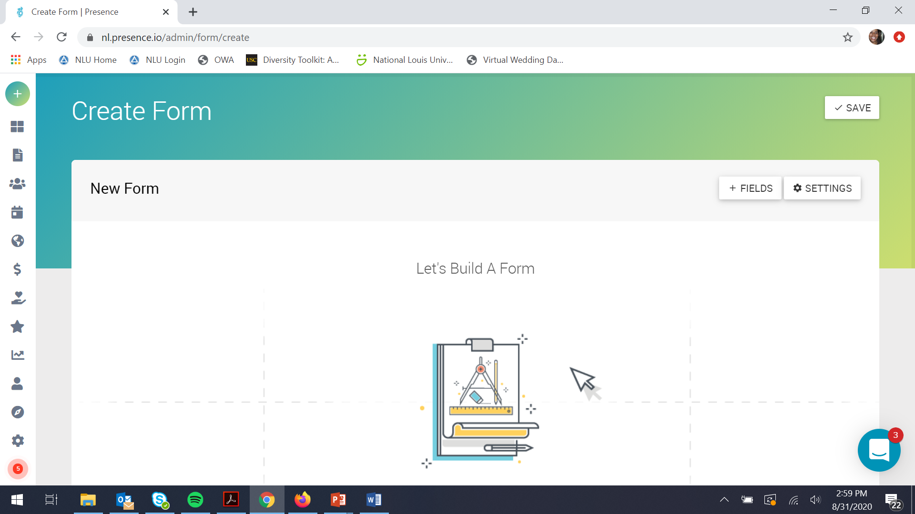
USING PRESENCE / EAGLE LIFE
Click on + sign
forms and + sign to create form
name your form by clicking on settings

Slide 22
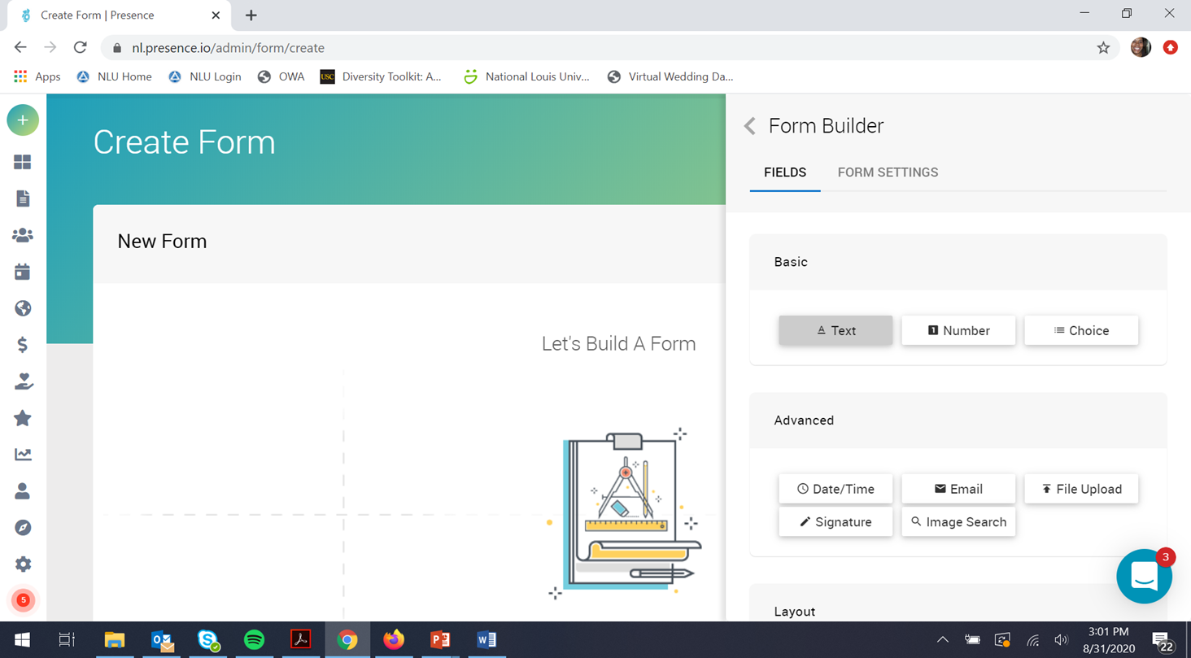
USING PRESENCE / EAGLE LIFE
To start your form select form select
By dragging style into the let’s build form space

Slide 23
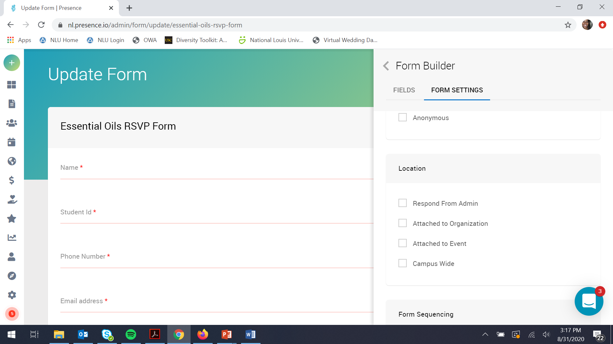
USING PRESENCE / EAGLE LIFE
To add your RSVP to your event
Click form settings, click visibility and select attach to event

Slide 24
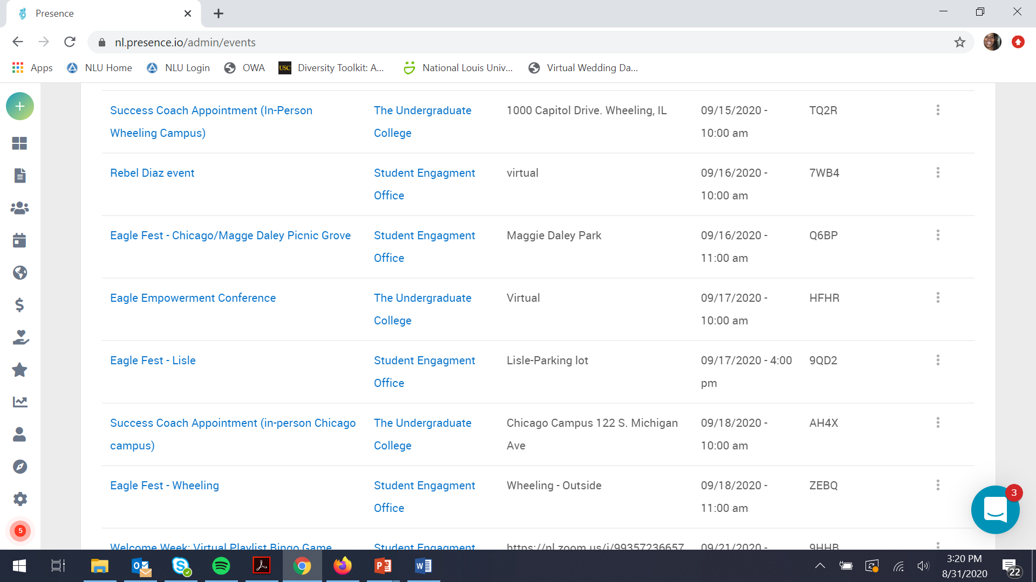
USING PRESENCE / EAGLE LIFE
Go to events, enter the dates of your event, select event

Slide 25
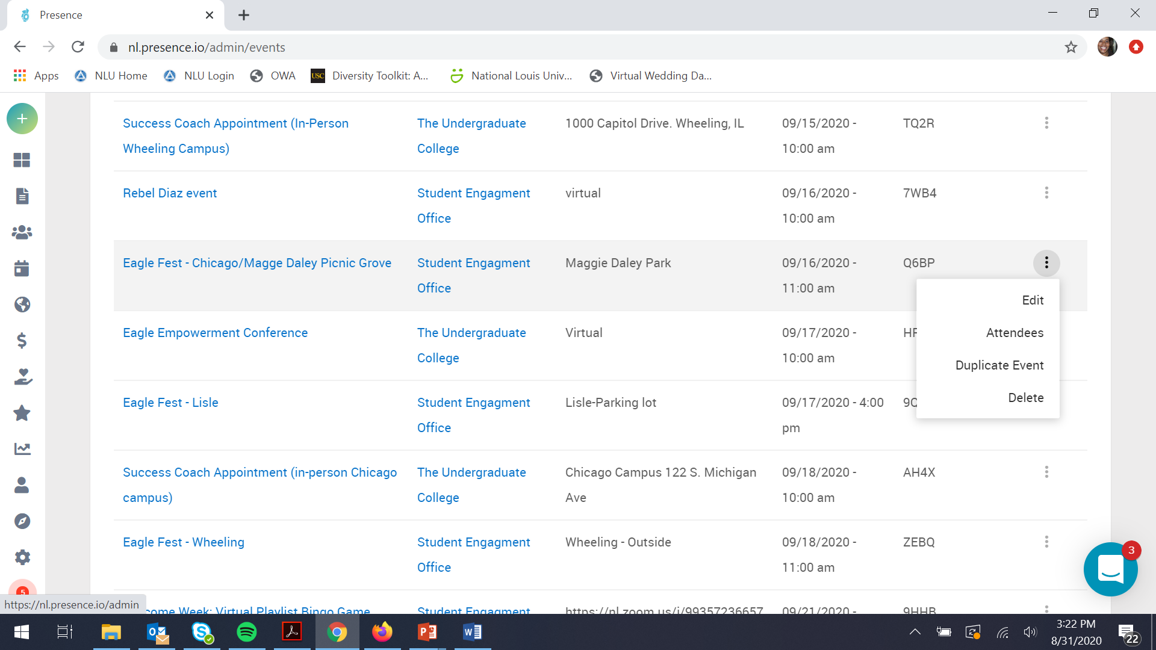
USING PRESENCE / EAGLE LIFE – TAKING ATTENDANCE
Go to events, enter the dates of your event, select event

Slide 26
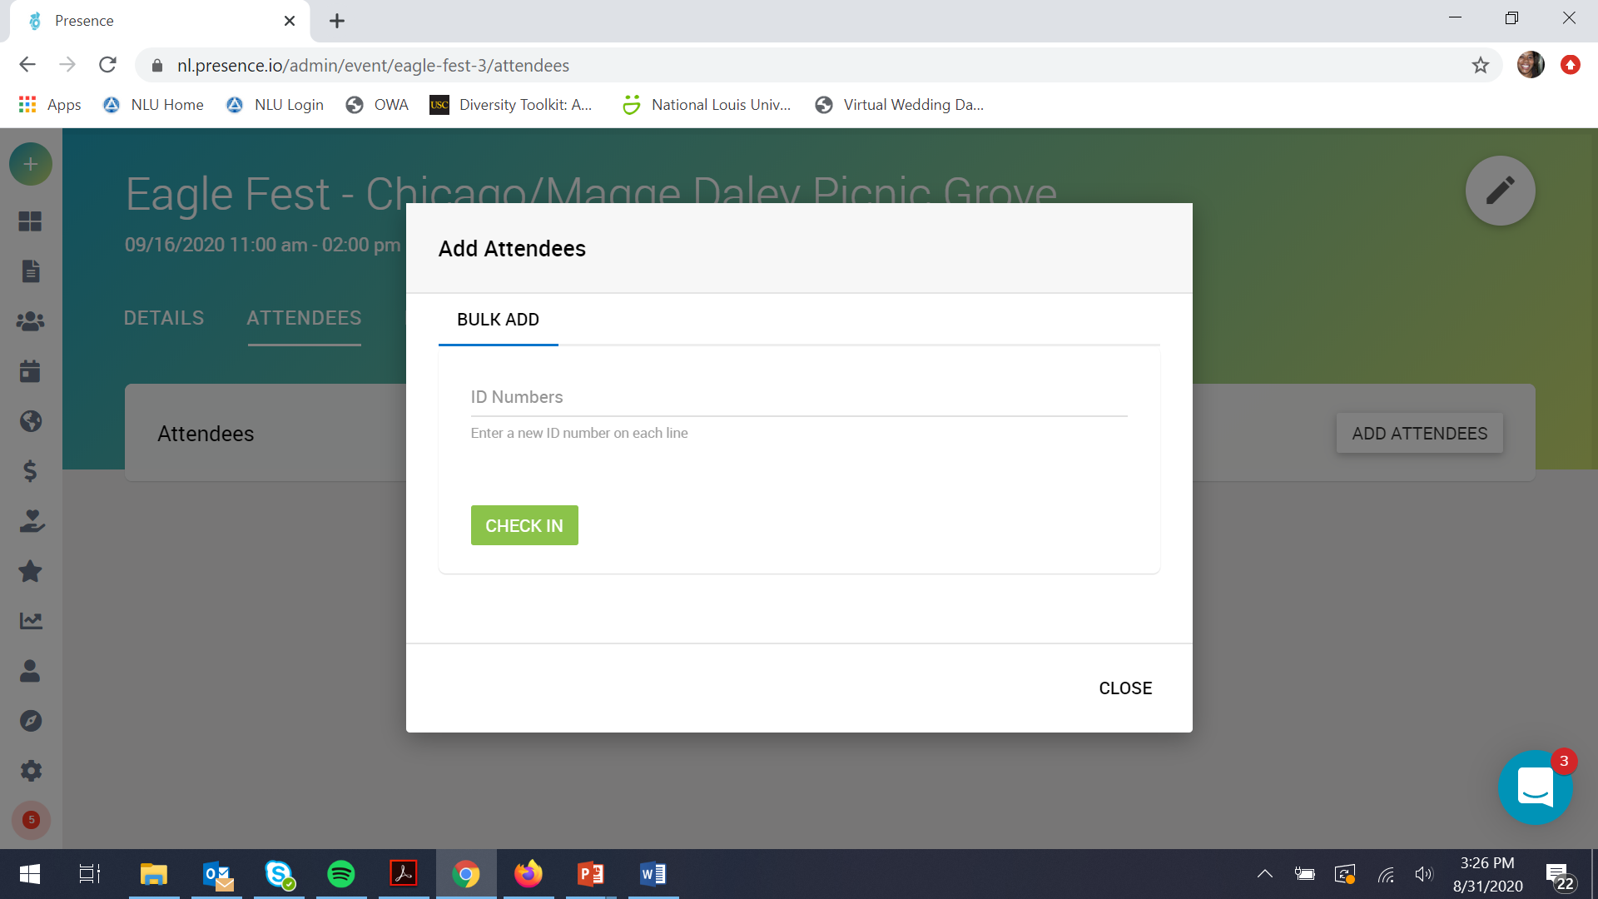
USING PRESENCE / EAGLE LIFE – TAKING ATTENDANCE
Click add attendees and add Id numbers and click check-in

Slide 27
BREAK FOR Questions

Slide 28
ENHANCED CLEANING
Frequent cleaning is occurring throughout the day at all high-tough areas throughout the University.
All rooms used for meeting or classes will be cleaned after such meeting or class is completed.
At the end of each day, all rooms (classrooms, offices ad conference rooms) used during the day are cleaned.
It is important that IDs are scanned upon entry to campus so we can have a record of which employees are on campus so we can know which offices to clean.

Slide 29
BREAK FOR Questions

