Slide 1
Grading for Equity:
Call to Engage
Jennifer Engelland-Schultz
Beth Minor
Joe Levy
National Louis University
Center for Teaching and Learning (CTLE)
October 2022

Slide 2
Learning Outcomes
Critique
1
Identify
2
Current grading practices using an equity lens
Opportunities to change grading practices to increase equitable outcomes

Slide 3
Grading for Equity
What is Our Why?
Notes:
Our experiences
Seed Grant
Improve our practices to support student learning

Slide 4
What are Our Current Grading Practices?
Survey
Notes:
Pre-Assessment
https://docs.google.com/forms/d/e/1FAIpQLSfk2b6m9BncKnPjh7E6R_E-dY048qIHIbkUWrOQPdzTBH5bcA/viewform?usp=sf_link
*We are still learning!
*Courageous Conversaitons

Slide 5
What are Our Current Grading Practices?
Recommended | Grading Practice
No | 0-100% grading scale
Yes | Minimum grading floors
No | Group grades
No | Late work penalties
No | Extra credit
No | Participation points
Yes | Retakes and resubmissions
Yes | Rubrics
No | Rounding up to the next letter grade
Yes | Student feedback on assessment and grading
Notes:
Do any of these recommendations surprise you?

Slide 6

Assessment & Grading
Assessment can be used to solve inequalities or perpetuate them (Montenegro & Henning, 2022, Ch. 1)
Equity gaps are a problem with the institute not the student (Singer-Freeman et al., 2022, Ch. 6)
We can leverage assessment to advance equity (Heiser & Levy, 2022, Ch. 13)
Socially Just Assessment is a transformative approach to dismantle systems of power and oppression (Baker & Henning, 2022, Ch. 4)
We need equitable assessment and grading practices…

Slide 7
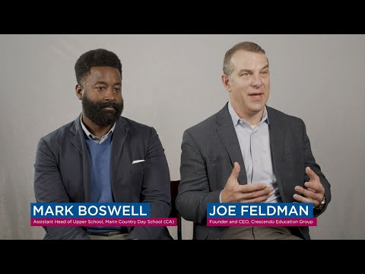
Grading for Equity
Notes:
Joe Feldman - Equitable grading practices
-Starts with history of Inequitable grading practices
-Traditional grading practices continue to be passed down and accepted
-He asks the questions: What are we doing, Why, Who is harmed, and How do we create equity

Slide 8
The Three Pillars of Grading for Equity
Accurate
2) Bias-Resistant
3) Motivational

Slide 9
Accurate
Grading Practices
Our Experiences
Equity Recommendations
*Grading Scales
*Zeros and Minimum Grading
*Individual Grades
*Completion vs. Accuracy
*What do you do?
*How do these practices affect our students?
Notes:
Jen

Slide 10
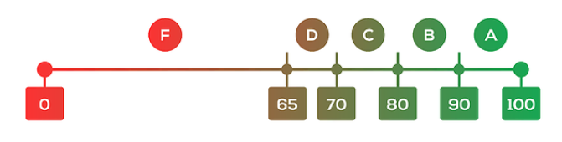
0-100% Grading Scale - Is it fair?
Photo Credit: Center for Assessment
Notes:
Jen

Slide 11
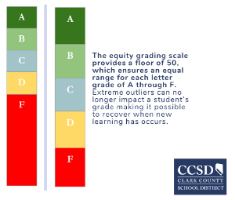
0-4 Grading Scale - Is it fair?
Photo Credit: CCSD Clark County School District
Notes:
Jen

Slide 12
2) Bias-Resistant
Grading Practices
Our Experiences
Equity Recommendations
*Late Work
*Participation Points
*Extra Credit
*What do you do?
*How do these practices affect our students?
Notes:
Beth

Slide 13
3) Motivational
Grading Practices
Our Experiences
Equity Recommendations
*Retakes
*Rubrics
*Student Support
*Student Voice
*What do you do?
*How do these practices affect our students?
Notes:
Jen?

Slide 14

Student Voice in Grading
Photo Credit: ajeforum.com
Notes:
Jen

Slide 15
NLU Seed Grant: Grading for Equity
What are our current grading policies?
What are our actual grading practices?
Do students’ current grades show equitable outcomes?
What should we be doing for grading policies and practices?
How do changes in grading practices and policies affect the equity of student outcomes?

Slide 16
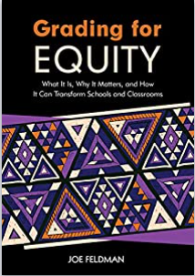
Joe Feldman’s
Grading for Equity
Notes:
Our experiences
Seed Grant
Improve our practices to support student learning

Slide 17
What are Our Next Steps for Grading Practices?
Survey
Notes:
POST-Assessment
https://docs.google.com/forms/d/e/1FAIpQLSdAoSJ2gmQbpaAYp_hmpBX5bjDy91lBAZuieYIeUZelI4ox_g/viewform?usp=sf_link
*Continued Conversations

Slide 18
Check & Connect
Grading for Equity Website
Beth Minor
Jennifer Engelland-Schultz
Joe Levy
Website
eminor1@nl.edu
Thank You!!!
Jengelland-schultz@nl.edu
jlevy2@nl.edu

