Slide 1

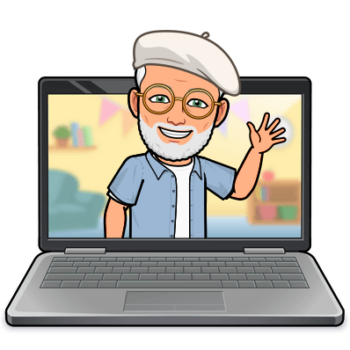
padlet for your classroom
Dr. Martin Cortez Wesley
Professor for Florida Online Counseling Programs

Slide 2

Agenda
Introduction to padlet for remote teaching
Purpose
Basics of making a padlet
Ways to use it in the classroom
Examples of projects
Sharing and taking a test drive
Q and A

Slide 3
What is padlet? Purpose?
Padlet is an interactive online bulletin board where students can post an array of different types of content and then see what their classmates are doing in real time.
When teaching online, it’s important to create opportunities for students to feel like they're still part of a community, even if that's only existing in a digital space.
Padlet offers free version, but it is limited to three padlets
A pro version is worth it if you are using in regularly.
Offers some great templates for different projects

Slide 4

Padlet ideas
Brainstorming and sharing ideas
Mind mapping in the classroom
Surveys and voting of these ideas, posters, photos and much more
School and Classroom announcements
Book Reviews and Discussions
Thank you walls
Collaborative posters
Student Projects or portfolios

Slide 5
Taking a look
The dashboard
Make a padlet and choosing a template
  Brainstorming type Templates
    Wall, Stream, grid, shelf
  Project specific
    International Map
    Canvas – using connections, great for mind mapping
    Timeline – great for reflective assignments.
New Padlet
Title and Description
Appearance settings
Address to share with others
Posting options
  ATTRIBUTION
  COMMENTS
  REACTIONS
    LIKE
    VOTE
    STAR
    GRADE
SHARING AND EXPORTING

Slide 6
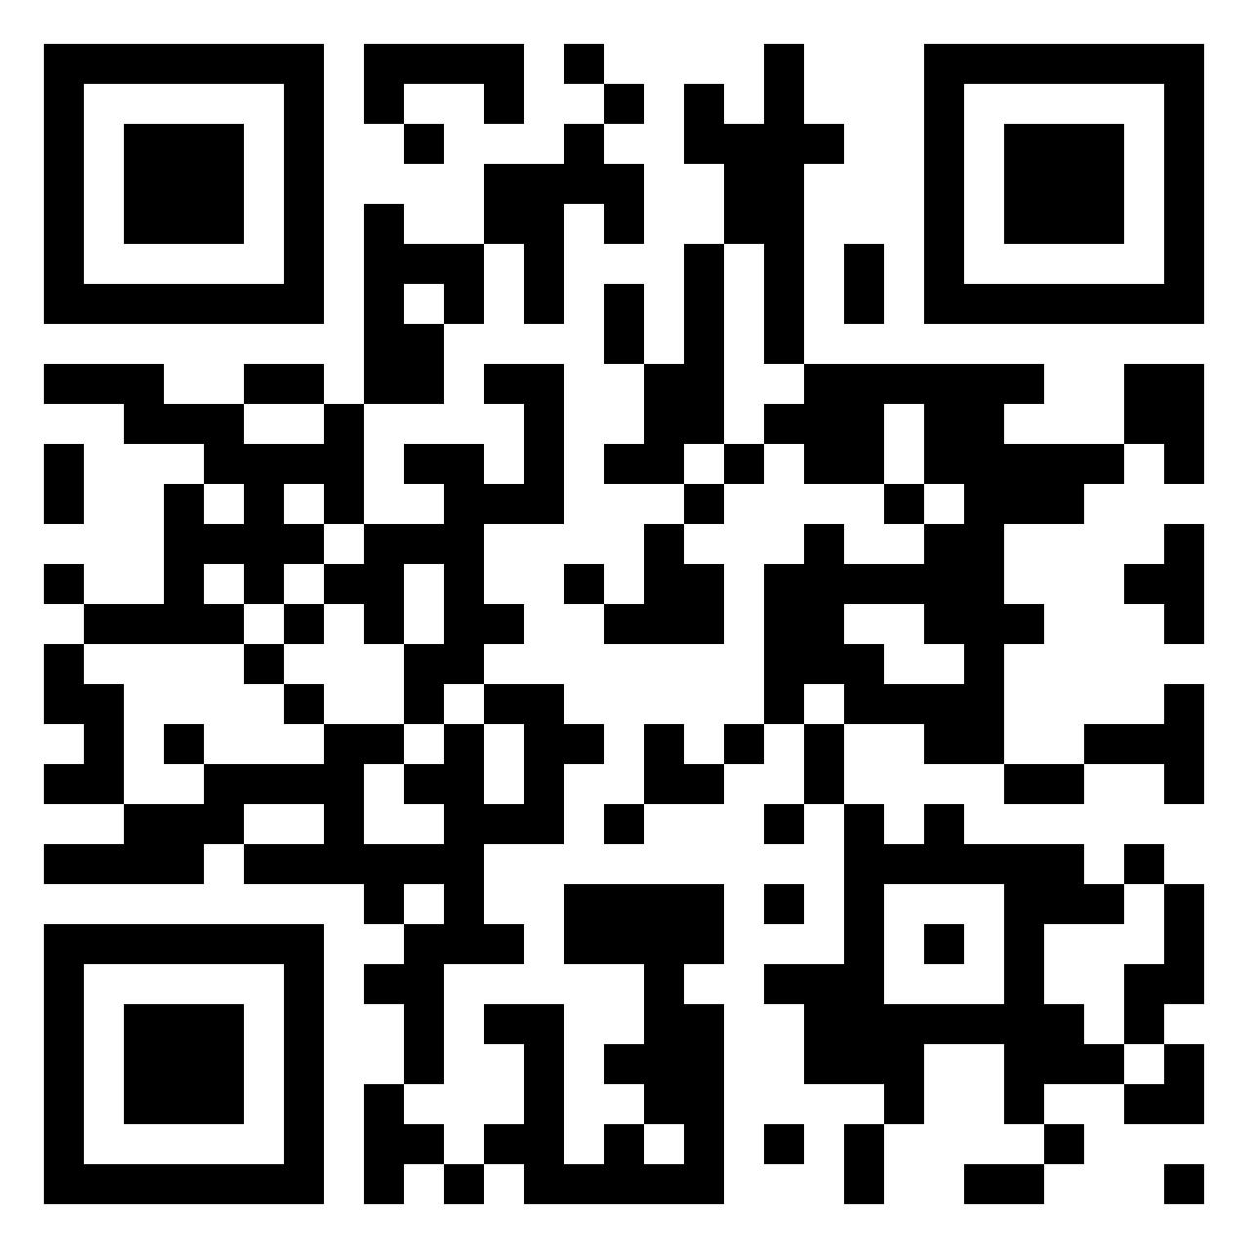
Demonstration
Show Brainstorming for SMHCA
SHOW MAP ON Sexual attitudes
SHOW TWO STUDENT timeline PROJECTS
  LAST LECTURE ASSIGNMENT
    Randy pausch
  Show exporting options
SHOW – TURNING ON THE GAS
ALLOW ACCESS TO BRAKING
HOW TO ACCESS BRAKING PADLET
https://nationallouisuniv.padlet.org/mwesley/wgdbx8uecuibjoxw

Slide 7
mwesley@nl.edu

