Slide 1
Remote Instructor Orientation
Winter 2022
January 11, 2022
Margeaux Temeltaş
Associate Director of Remote and Online Academics
Undergraduate College (UGC)

Slide 2
Workshop Description and Intention
NLU Remote Instructor Orientation – Winter 2022
This workshop will now be offered twice (same content):
Tuesday, January 11, 2022 at 2pm Central Time (hosted by the UGC)
Friday, January 14, 2022 at 1pm Central Time (hosted by the CTLE)
Zoom location for both sessions: https://nl.zoom.us/j/93665618377
This zoom session will cover basics and best practices of remote/virtual (synchronous online) instruction at NLU, while modelling some student engagement strategies for the virtual classroom. Instructors new to remote, as well as those wanting to develop their practice, are welcome. This workshop will be recorded and shared for those who cannot attend. Faculty are welcome to attend either session, regardless of college affiliation. Content will be the same.
And a word on intention…

Slide 3
Course Designation and Modality
Designation in NLU Course Schedule
Campus: Virtual Classroom
Building: No Rm
Room: Zoom
Instructional modality
Course is taught via regular synchronous zoom sessions.
Time/days as listed in course schedule
AKA “Remote”
Designation in NLU Course Schedule
Campus: On-Line
Building: No Rm
Room: On Line
Instructional modality
Course is asynchronous.
Synchronous zoom session (“meet and greet”) in week 1 is encouraged, though optional for students
AKA “Online”

Slide 4

Workshop Agenda
Introductions (class biography; Slido; norms)
Journal
Breakout Rooms (journal share, 3-4 per group)
  Cameras on during breakouts if possible
  Share mic time equitably
Basics & Best Practices (slides)
Collaborative Annotation in Googledocs
Zoom Chat Waterfall (reflection question)
After this workshop is over, check out the Appendix at the end of this slide deck for lots of additional resources and answers to FAQs.

Slide 5
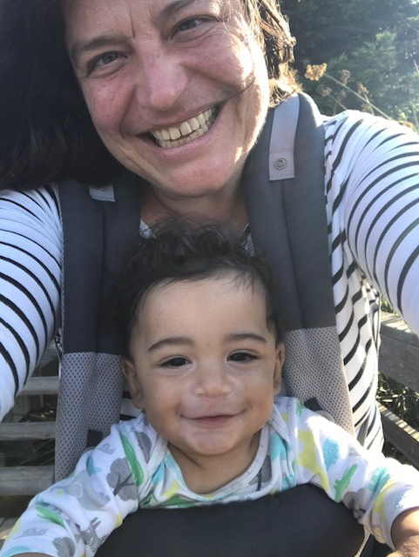
Who am I?
Margeaux Temeltaş (she/her)
Associate Director of Remote and Online Academics, NLU Undergraduate College
Associate Professor and previous UGC English Department Chair
19 years as a teacher (6+ years at NLU)
Taught all modalities: in-person, blended, remote, and asynchronous online
Voracious reader, sometime writer, yoga enthusiast, and mother of Langston
Happiest barefoot
Sample class biography slides

Slide 6
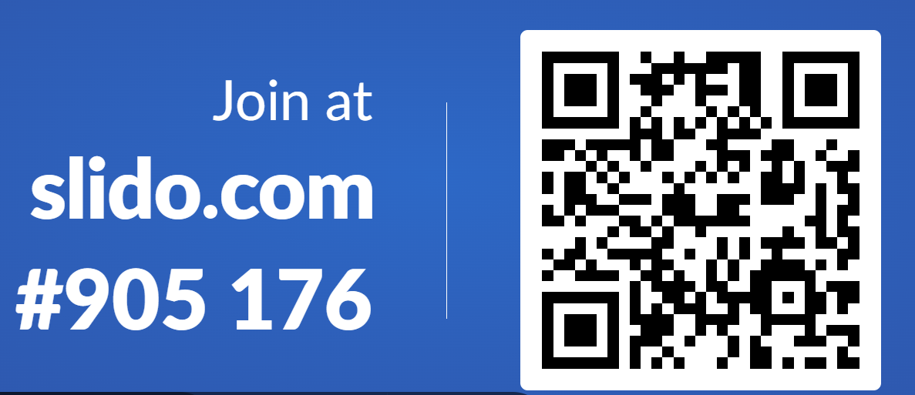
Who are we?
Slido about today’s workshop participants.

Slide 7
CLASS NORMS:
Zoom video on when possible & appropriate.
BE ENGAGED.
Instead of thinking, “I know this already,” try “What can I learn from this?”
One voice at a time.
Listen well.
Leave your judgment at the door.
THIS IS A SAFE SPACE.
THIS IS A BRAVE SPACE.
Try your best. Work at your “appropriate edge.”

Slide 8
DO NOW:
Journal
Describe a really positive teaching experience from the past 1-2 years.
What made it special?
How might you plan with intention, in the upcoming term, to enable such moments again?
Write for 5 minutes.
You will not have to turn this in,
but you will discuss your response
with 2 or 3 colleagues in breakouts.

Slide 9
DO NOW:
Journal
EXAMPLE
Choose one topic:
A time you were judged unfairly or underestimated
Overcoming obstacles in your own life
What inspires your passion
What motivates you
A moment or experience that changed your life
A time you had to fight for something
The role that writing does or will play in your life
Write for 15 minutes.
Submit by 11:59pm tonight to the Module 2: In-Class Activities Dropbox

Slide 10
BREAKOUT ROOMS:
Journal Share
Describe a really positive teaching experience from the past 1-2 years.
What made it special?
How might you plan with intention, in the upcoming term, to enable such moments again?

Slide 11
We are all Human
Compassionate self-reflection on your own experiences, teaching/working online and living during this pandemic, may help you shape a better virtual learning experience for your students.
For example, think of how YOU feel after 2 or 3 hours of zoom meetings with no physical break to move your body or meet your needs. Your students may be regularly attending 6 hours of zoom class in a single day! Consider this when designing your 2-3 hour synchronous zoom session.
Schedule breaks and stick to them. Build in a scheduled physical break every 60 minutes if possible, 90 minutes at most.
We are all human.
We are all tired.

Slide 12

Best Practices for the Synchronous Zoom Session:
Schedule health breaks during class and keep to them.
Be intentional about remembering to give 1-2 breaks every session. Schedule them into your lesson agenda and set alarms if needed.
Offer healthful suggestions for students about what to do during the breaks (a simple stretch routine, for example, or a guided meditation).
Remind students (and yourself) to give your eyes breaks by getting up from the screen and looking at objects in the room.
Take care of your own needs too!
Don’t go more than 90 minutes (60 is better)
without building in some steps or
other physical movement.

Slide 13

Humanize Your Course
Build community intentionally, investing time and planning on developing instructor-student and student-student relationships.
Build connections between the course and students’ identities, lives, and goals. There are ways to do this in any discipline.
The most meaningful and effective learning happens when all 3 domains of learning are incorporated:
  Cognitive
  Emotional/Social
  Physical

Slide 14
Humanize Your Course
“Accessibility”
Making your course “accessible” is not only about accommodating disabilities and diverse cognitive or physical needs - it is also about thoughtfulness and flexibility regarding:
  Inequitable access to wifi, other technology, or a quiet workspace
  Accommodating working, parenting, sick, and otherwise human students with extensions on assignment deadlines when needed
  Zoom classroom policies and practices that do not exacerbate trauma, reinforce gender inequities, or otherwise interfere with learning

Slide 15
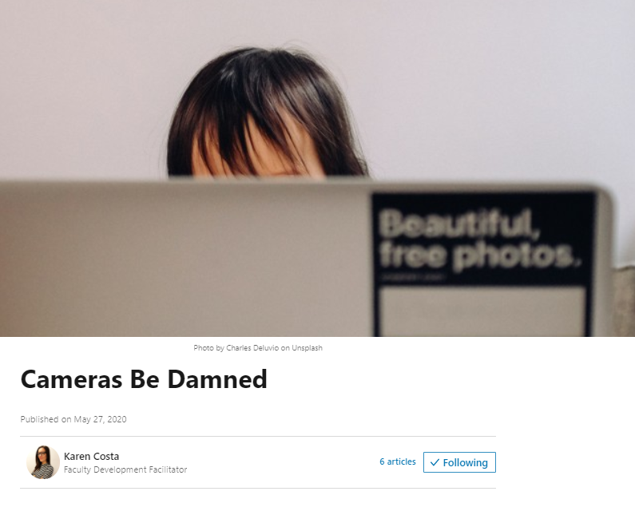
A word about cameras
Early on, many of us thought cameras were a sure way to ensure engagement. Now we know that requiring cameras on can do more harm than good. There are many other powerful engagement strategies. Check out this article.

Slide 16
Zoom Cameras
Never require students to have their Zoom cameras on or grade them down for choosing to keep their camera off. This is informed by trauma-informed pedagogy, as well as equity and accessibility considerations. Possible exception: formal presentations, as in a speech class.
Instead of mandates, create an environment where students WANT to engage, and CHOOSE to turn their mic/cameras on when possible and suitable.
There are many ways for students to demonstrate their “presence” and to engage, and for the instructor to check student understanding, besides being on camera:
  Zoom Chat (whole class and instructor-only)
  Collaborative Googledoc, Googleslides, or Jamboard
  Padlet, Slido, etc.
  Informal writing prompts

Slide 17
Zoom Cameras
Discuss and decide with your class some shared norms for when cameras-on makes sense, knowing there will be exceptions. Examples:
  Cameras on when in small group breakouts.
  Cameras on when presenting to the class.
  Cameras on when meeting with professional visitors to class.
Show students how to hide their own Zoom camera window so they don't have to look at themselves even when their camera is on.
Don’t assume that a student is disengaged simply because they are muted and/or their camera is off. Provide diverse and multi-modal opportunities for engagement.
Make sure students know how to set a virtual background and profile picture in Zoom.

Slide 18
Best Practices for the Synchronous Zoom Session:
Make your zoom classroom easy to access.
Use a consistent zoom classroom and make sure that the link is posted clearly and in multiple modalities (email, D2L announcement, syllabus).
Communicate the zoom classroom link well in advance of the first class session.
Use a consistent zoom room for office hours and communicate your 1-1 availability clearly and regularly.
Be sure that coaches, department chairs, and the online concierge have access to your virtual classroom location. Undergraduate (UGC) instructors, add your zoom link to the UGC Master Course Links and Office Hours spreadsheet (Winter 2022 tab) ASAP.

Slide 19
Tech Tools
Zoom + D2L + Panopto + Google Tools
= about 80% of what you need to get going the first two weeks for during-class and out-of-class work
Zoom Checklist
Do you have your permanent Zoom link for the quarter? (See Setting up a permanent Zoom link)
Do you know how to share your screen during a meeting? (See Sharing your screen)
Do you know how to share your screen when playing a video? (See Sharing your screen)
Can you get to your usage reports (see attendance)? (See Usage reports)
Have you activated breakout rooms? (See Breakout rooms)
Do you know how to record a meeting and share the recording? (See Recording)
Can you find the Zoom chat window? (See Chat features)
Do you know where to go to manage participants? (See Managing participants)
Google Apps Basics Checklist
Do you know how to create a Google account using your NLU email address? (see Creating a new account)
Do you know how to create a new Google item (Docs, Slides, Sheets, etc.)? (see The “+ New” button)
Do you know how to share a Google item with students so they can view? (see The Share button)
Do you know how to share a Google file with students so they can edit? (see The Share button)
Do you know organize your Google Drive? (see Organization)
How can students set up a Google folder and give you access? (see The Share button)

Slide 20

Options for 3 hour weekly virtual sections:
a well-structured, 3 hour synchronous session with healthful breaks.
a well-structured, 90-120 minute synchronous session combined with 60-90 minutes of structured asynchronous instructional activities.
Undergraduate College
Synchronous Learning Expectations

Slide 21
Sample lesson structure - Week 1
100 MINUTES LIVE ZOOM (SYNCHRONOUS)
30 min: settle in, break the ice
Resolve connection issues, get to know the group (icebreaker/community building activities, keeping it real)
    Check-ins are always welcome, especially in times of high stress - “Maslow before Bloom”
    Here are some whole-class icebreaker ideas
30 min: course and community overview
Get students excited about the class, what to look forward to, how the class fits into the major, relates to future careers, and to life
    Be as clear as possible with expectations, with reminding everyone that this is new for everyone and adjustments will be needed.
    Perhaps also address Zoom meeting norms (or have the class come up with them together), including clothing, when to mute, presence, camera preferences, etc.
30 min: active learning
  TIMING: 10 minutes set-up and direct instruction / 10-15 minutes small-group to discover, apply, extend, process, personalize the new information and turn it into knowledge / 10 minutes large group discussion to share out, debrief, reflect
  TIPS:
    Provide clear instructions before sending students off into small groups.
    Include instruction reminders on their note catcher itself
    You might use a Zoom poll to set up the activity or assess understanding.
    Faculty and students love using breakout rooms.
10 min: wrap-up or transition
  Wrap-up (Set-up for assignments and online discussions (preview assignments, discuss expectations using a model or checklist), exit slip)
  - OR - Set up (Get the class ready for the next group activity)
80 MINUTES FLEX TIME
ASYNCHRONOUS LEARNING ACTIVITIES
Pre-recorded lectures
Interactive videos
Independent task-based work, followed by check-in with instructor (e.g., work on an accounting problem, write code)
Additional discussion board questions
or MORE SYNCHRONOUS ACTIVITIES
Case studies using breakout rooms
Co-creating on a collaborative document
Think-pair-share (could use chat feature for pair)
Role-play, simulations

Slide 22
Best Practices for the Synchronous Zoom Session:
Break up the time into a variety of active learning experiences.
Small group work in collaboration.
Partner work and peer reviews.
Student-centered, whole class discussion.
Small group discussion & share to whole class.
Structured independent work time with instructor checkpoints.
Virtual field trips with reflections or reports back.
1-1 meetings with students (while the class is engaged in partner, group, or solo work). Breakout rooms work well for 1-1 meetings.
Consider inviting a writing, math, or learning specialist to your virtual classroom who can work with students 1-1 or in small groups during the synchronous zoom session (in a breakout room).

Slide 23
Best Practices for the Synchronous Zoom Session:
Break up the time into a variety of active learning experiences.
Incorporate student voice regularly through a variety of modalities - sharing aloud, structured discussion, zoom chat, padlet, and other technologies.
Try a “waterfall” approach to zoom chat responses to encourage 100% participation and more effective comprehension check.
Consider utilizing a consistent “Do Now” activity (journal, quizlet) to begin class. Regular structures to the daily agenda help create consistency for students.
Combine attendance-taking with a more meaningful activity (such as a check-in using Googledocs, Padlet, or Jamboard) to set the tone and gauge students’ mood and needs.
Incorporate regular informal writing opportunities.

Slide 24
Collaborative Annotation in Googledocs
“Instructional Strategies for Remote Teaching”
Click this link to go to the Googledoc. You should have “Comment” access.
Read through the document.
Add a Comment by right-clicking on the text you are referring to, and selecting “Comment.”
Your comments may include:
a question you have
a tool or resource to recommend
an answer to someone else’s question
a response to the text or to a colleague’s comment
Be engaged.
Be kind.

Slide 25
Best Practices for the Synchronous Zoom Session:
Make your zoom classroom easy to access.
Set expectations for zoom camera usage up front and be consistent with them.
Break up the time into a variety of active learning experiences.
Schedule health breaks during class and keep to them.
Intentionally build community and infuse culturally responsive practices into your virtual classroom. ← click link for CRT resource
Remember, a 3 hour synchronous session does not mean a 3 hour lecture! Students may be collaborating in groups or partners, working independently, or meeting 1-1 with the instructor or a learning specialist. They may even go on a virtual field trip; just make sure there is a checkpoint back in the zoom classroom.

Slide 26
Reflection - Zoom Chat “Waterfall”
What is one new strategy or approach you are going to try this quarter in your synchronous Zoom classes?
Type your response into the Zoom Chat window but
do not press Enter until Margeaux says so!

Slide 27
Recommended Professional Development:
Excellence in Online and Remote Teaching (EORT)
All instructors teaching virtual/remote courses in the UGC are strongly encouraged to participate in the Excellence in Online and Remote Teaching (“EORT”) course offered quarterly through the Center for Teaching and Learning Excellence at NLU.
Register here for the Excellence in Online and Remote Teaching course for the upcoming term.
EORT includes readings, resources, asynchronous discussion activities, and periodic synchronous workshops (aka Faculty Forum), typically on Fridays during the quarter.
EORT is free, self-paced, and you only need to consume what is most meaningful to you!

Slide 28
Recommended Professional Development:
Excellence in Online and Remote Teaching (EORT)
EORT is self-paced - you only need to engage in the modules most meaningful to you! You can return to other modules on your own time as desired.
Module 1: Beginning Your Course
Module 2: Online and Remote Teaching Foundations
Module 3: Creating Faculty Presence in an Online Environment
Module 4: Teaching Your Course: Engaging Students Synchronously
Modules 5 & 6: Teaching Your Course: Engaging Students Asynchronously
Module 7: Teaching Your Course: Data-Driven Instruction
Module 8: Wrapping Up Your Course
Module 9: Bimodal Teaching

Slide 29
Reminder!
Undergraduate College (UGC) only
Add your Zoom classroom link to the UGC Master Course Links and Office Hours spreadsheet (Winter 2022 tab)
by Friday 1/14/22

Slide 30
Reminder!
Monday, January 17, 2022 is a holiday in honor of Dr. Martin Luther King.
Do not hold classes,
via Zoom or otherwise.
You may schedule optional Zoom meetups later in the week if desired.

Slide 31

Thank you for your engaged participation!
Have a wonderful Winter Quarter.
Feel free to contact me directly with questions:
Margeaux Temeltaş
Associate Director of Remote and Online Academics
mtemeltas@nl.edu

Slide 32
Appendix
The following slides include a variety of information and resources related to remote instruction at NLU. Please review them on your own.

Slide 33
Resources
NLU Live Support: https://live-support.nl.edu/
Zoom Help Center
Activity ideas (crowdsourced from NLU faculty)
NLU’s University Continuity Site
NLU’s Teaching Remotely page

Slide 34
Additional Resources and Recorded Workshops
Adapting Your Course to Remote Online (PPT for those new to remote)
Engaging Synchronous Sessions: Using Google Slides for Community, Consistency, and Collaboration, Margeaux Temeltas
  Recorded Zoom session
  Slides
NLU’s Center for Teaching and Learning Excellence (CTLE) online teaching resources, including:
  ADA Accessibility & Accommodations in a Remote Learning Environment, Kaydra Bui and Kendra Syed-Abdul
  Exemplifying Social Justice Allyship in the Synchronous Classroom Setting, Caroline Perjessy
  Pulling the Weeds in Your Remote Garden, Renee Gugel and Elizabeth Minor
  Synchronous Lecture Delivery, Bettyjo Bouchey

Slide 35

New for 2021-22:
Zoom-D2L Integration
is now available!
There is a new, seamless way to set up Zoom meetings for your class and share them on a dedicated calendar page in Content, inside D2L. Visit the Zoom-D2L Integration page linked below for more information, including a video and step-by-step instructions with screenshots.
https://oit.nl.edu/rich_content/LMS/WhatNew/ZoomSteps.html

Slide 36

Undergraduate College
Key Difference for 2021-22:
Student Choice
For freshman and sophomore daytime courses, students choose their modality - virtual or in-person - during registration.
For junior and senior courses, modality is determined by course type.

Slide 37
Scheduling Virtual (VC) and In-person (F2F) Courses
Undergraduate College
Freshman and Sophomore daytime courses:
VC and F2F options are offered on both days.
Freshmen: Monday/Wednesday
Sophomores: Tuesday/Thursday
Junior and Senior (major) daytime courses:
Major courses F2F, minor/concentration courses VC
Juniors: Tuesday F2F / Thursday VC
Seniors: Monday F2F / Wednesday VC
*Note these describe typical scheduling for 2021-22, but there may be some exceptions.

Slide 38
FAQ: What is the zoom camera policy?
NLU Guidelines for Zoom Camera Use in Virtual Classes:
Faculty should encourage students to turn cameras on at least twice during each class meeting, and ideally as much as possible.
Faculty should set classroom norms - including camera usage norms - at the start of the term along with a discussion with students about why camera use is important (e.g., for connection, building communication skills, helping to check for understanding, preparing for employer expectations). These norms should be developed with students’ input during Week 1 classes.
Faculty should use their professional judgement about which class activities are best suited for on-camera student engagement and when to consider exceptions to the guidance above. Some suggested times for on-camera engagement are:
  During attendance
  During in-class discussions and activities
  During break out groups
  While assignment instructions are being reviewed
  Any time a guest speaker is in the classroom, especially employers

Slide 39
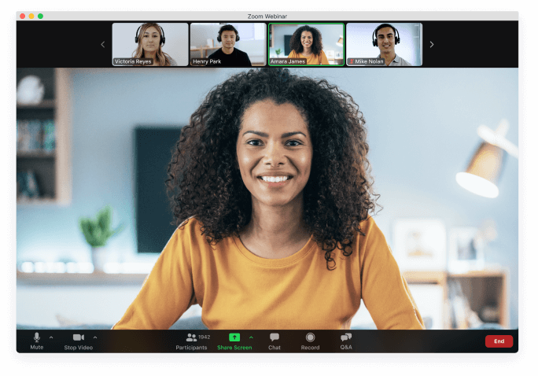
FAQ: What is the zoom camera policy?
NLU Guidelines for Zoom Camera Use in Virtual Classes:
As always, some students will identify extenuating circumstances for keeping their cameras off, and faculty should make exceptions to provide the best student experience.
Students should not be penalized if they have their cameras off during class time; yet, we hope students will engage with the above guidance as much as possible because of the connection, learning, and career readiness benefits. We also understand extenuating circumstances and ask that students let us know of any barriers to camera use, especially because the barriers might be things we can help them with, such as technology access or use of a virtual background.
Faculty are not expected to track camera usage as part of their teaching responsibilities.

Slide 40

FAQ: What is the late work policy for virtual classes?
The late work policy in a virtual section should be consistent with your college’s late work policy, as articulated on the master course syllabus.
Know your students’ approved ADA accommodations and honor them. (Consider setting consistent, personalized deadlines for those students.)
Extended time for extenuating circumstances remain at the instructor’s discretion, per NLU policy.
Communication is key. Students should communicate requests for extra time before the due date whenever possible.

Slide 41
NLU - Preparing for Student Success
Student Support Needed - feedback from students | SOLUTIONS - https://nl.edu/return/remote-learning/
Access to technology and technology assistance | Computer labs at the Chicago and Wheeling campuses will be available for student use. The Student Support Concierge is available via zoom Monday – Friday from 9am – 5pm to assist. 24/7 technical assistance is available at (866) 813-1177 or helpdesk@nl.edu.
Finding quiet and dedicated space at home for zoom classes and homework | Dedicated classrooms will be available at the Chicago and Wheeling campuses for students. More information to come related to days, times, and locations.
Personal Support – Coaching, Career, and other Support Services | Instructors, Coaches, and Career staff will hold virtual office hours. Virtual Study Tables and 1:1 meetings with Writing/Math Specialists, Learning Specialists, and Peer Tutors will be held via Zoom.

Slide 42
NLU - Preparing for Student Success
Student Support Needed - feedback from students | SOLUTIONS - https://nl.edu/return/remote-learning/
Student Engagement in College Life | On campus and virtual events are being planned for the fall term in compliance with all health and safety regulations. This year, Eagle Fest will kick off the year for students.
Mental Health Concerns | Jillion Caldwell is our new counselor for daytime undergraduate students. She is available at jcaldwell7@nl.edu. Counseling services for transfer and online undergraduate students also continues to be available through Skylight Counseling Center. There is now a dedicated space for Counseling and Wellness located on the 4th floor at 122 S. Michigan. https://www.nl.edu/studentservices/studentexperience/studentwellness/ https://nl.edu/food-pantry-and-thrive-resources/campus-and-community-resources/ https://www.nl.edu/continue/continuethriving
Financial Assistance | NLU Emergency Fund NLU Tuition Completion Program COVID Scholarships Summer Credit Recovery Scholarships

Slide 43
Optimizing Digital Learning Experiences: A Checklist
Supporting Student Learning through Effective Design
Create and maintain an inclusive and equitable digital learning environment.
Strive for alignment between learning outcomes, learning experiences, assessment practices, and technology integration.
Be consistent.
Adapted from Optimizing High-Quality Digital Learning Experiences: A Playbook for Faculty.

Slide 44
Optimizing Digital Learning Experiences: A Checklist
Building Your Syllabus, Course Schedule, & Communication Plan
Build your course with predictable learning cycles to help students find rhythm and consistency with assignments and due dates.
Include a statement on your syllabus about expected email response times to let students know how much time might pass before receiving a response from you.
Provide clear expectations for when students can expect to receive feedback on their work.
Create conditions to encourage your students to log into the digital classroom each day.
Ensure that your digital classroom, such as your D2L course shell, is well-organized.
Adapted from Optimizing High-Quality Digital Learning Experiences: A Playbook for Faculty.

Slide 45
Optimizing Digital Learning Experiences: A Checklist
Create Instructor Presence and a Sense of Community
Use active learning strategies during synchronous meetings.
Be easily accessible to your students.
Send weekly announcements or a weekly task checklist to your students.
When communicating with your students in writing, aim to use a welcoming and encouraging tone.
Adapted from Optimizing High-Quality Digital Learning Experiences: A Playbook for Faculty.

Slide 46
Recommended Reading
Adams, S., Bali, M., Eder, Z., Fladd, L., Garrett, K., Garth-McCullough, R., Gibson, A. M., Gunder, A., Iuzzini, J., Knott, J. L., Rafferty, J. & Weber, N. L. (2021 June 8). Caring for students playbook. Every Learner Everywhere. https://www.everylearnereverywhere.org/resources/.
Gunder, A., Vignare, K., Adams, S., McGuire, A., & Rafferty, J. (2021, June 8). Optimizing high-quality digital learning experiences: A playbook for faculty. Every Learner Everywhere. https://www.everylearnereverywhere.org/resources/.
Rhodes, C. M., & Schmidt, S. W. (2018, November). Culturally responsive teaching in the online classroom. eLearn Magazine. https://elearnmag.acm.org/archive.cfm?aid=3274756.

