Slide 1

Using LinkedIn to Engage with Students Beyond the Classroom
Uzoma F. Obidike, M.S.Ed.
Assistant Professor, Career Development
Undergraduate College

Slide 2


LinkedIn is the world’s largest professional network with over 800 million users.
National Louis University students are required to create LinkedIn profiles and connect with faculty as part of the CAR/BRV curriculum.
Therefore, it is essential for NLU faculty to utilize the platform as a model for our students and to further engage with them beyond the classroom.
In addition, using LinkedIn to promote program and institutional initiatives, as well as individual accomplishments, will increase NLU’s presence across a broader network.

Slide 3
Purpose of LinkedIn
“LinkedIn is no longer just a place to just find people. It’s a place of personal and professional growth, a place of business growth, a place of economic growth, and a place that makes a difference in professional lives. It’s a community where you can be inspired, build relationships and discover unexpected opportunities.”
https://blog.linkedin.com

Slide 4
PROFILE COMPLETION
Key components to include on your LinkedIn profile to showcase your personal and professional brand
01
RELATIONSHIP BUILDING
How to thoughtfully engage with current students, alumni, and the NLU community to establish and nurture long-lasting relationships
02
THOUGHT LEADERSHIP
The best types of content to share on your newsfeed to encourage meaningful conversations amongst your LinkedIn connections
03

Slide 5

Why are you on LinkedIn?

Slide 6

Primary Goal
  Find a job
  Maintain a professional presence
  Create and maintain professional relationships
  Stay current on industry news and trends
  Gain new skills
  Attract business leads

Slide 7


PROFILE COMPLETION

Slide 8

Profile Completion
  Improve the discoverability of your profile in search results
  Increase profile views
  Establish credibility and trust
  Display your active presence on the platform

Slide 9
Profile Completion
  Photo
  Background Photo
  Headline
  Location
  About
  Experience
  Education
  Skills
  Featured
  Recommendations
  Additional (Awards, Publications, Volunteer Experience, etc.)
  Connections
  Custom URL

Slide 10
Profile Completion
  Photo
  Background Photo
  Headline
  Location
  About
  Experience
  Education
  Skills
  Featured
  Recommendations
  Additional (Awards, Publications, Volunteer Experience, etc.)
  Connections
  Custom URL

Slide 11

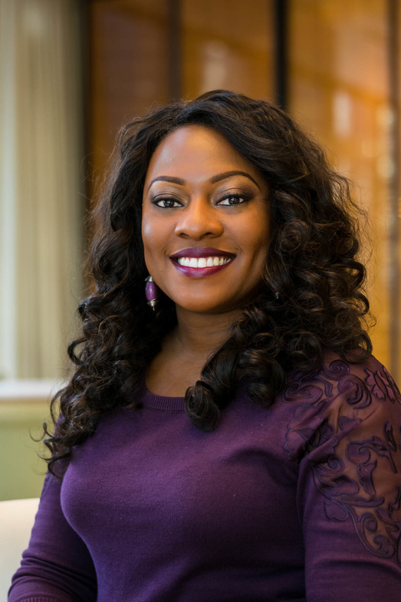
Background Photo

Slide 12



Background Photo
  Premade LinkedIn templates
  Use a copyright-free image (Unsplash.com / Pexels.com)
  Design your own (Canva.com)
    Name logo
    Contact information
    Promote NLU event

Slide 13
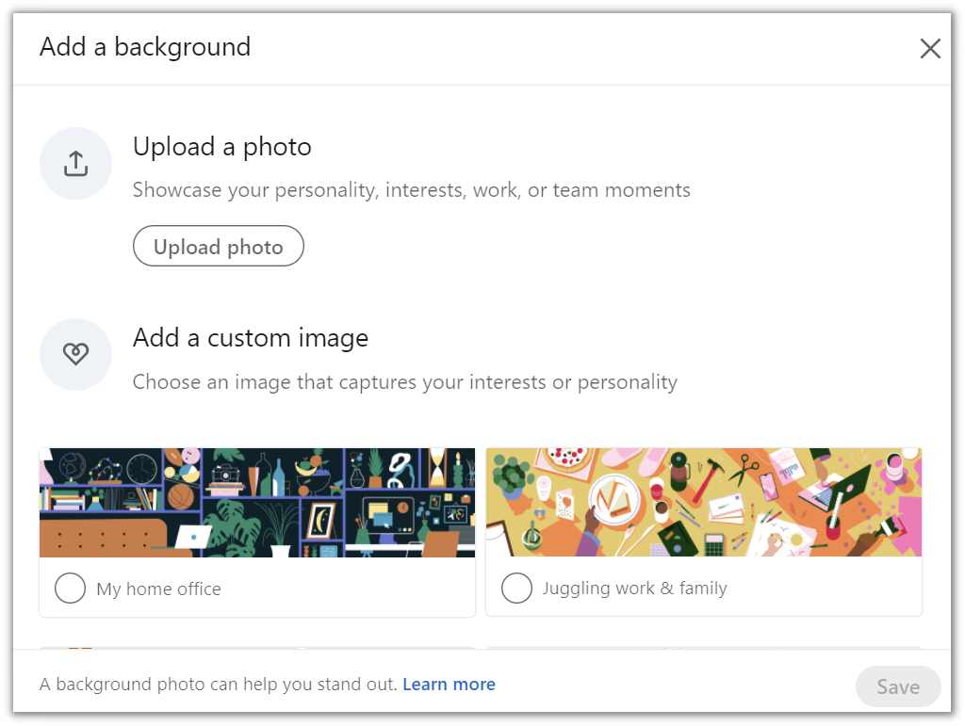
Background Photo

Slide 14
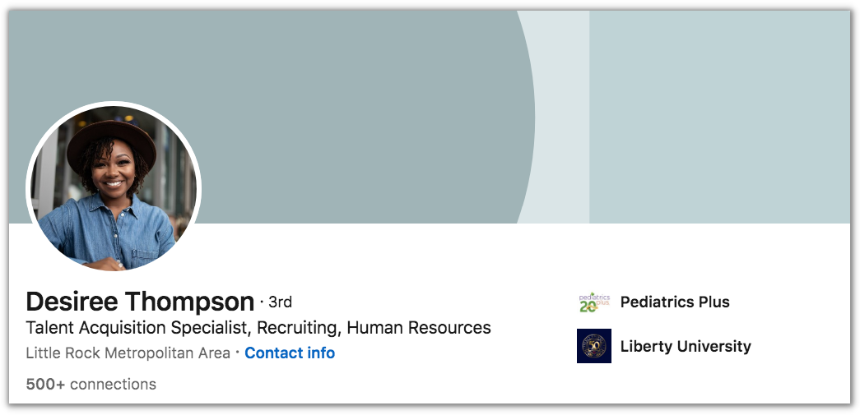

Headline
Firstname Lastname
(She/Her)
Director of Recruitment & Selection | Career & Talent Development

Slide 15
Headline
Firstname Lastname
(She/Her)
Content Strategist | Speaker | Writing Coach | Connect with me!

Slide 16
Headline
Firstname Lastname
(She/Her)
VP @ Website.com | Overseeing Publishing, Community & Events Teams

Slide 17

About
  Does not have to be your standard bio
  Write in first person POV
  Begin with a strong hook
  Tell a story
  End with a call to action
  You have a character limit of 2,500
  Remember your audience - "WIIFM?"

Slide 18
Strengths-based leadership is the central focus of my career and I believe that anyone can be successful when they maximize and showcase their strengths. Uzoma means “the road is good” in the Igbo/Nigerian language. Since college, I began using an interpretation of my name as a personal mantra... "Any road I take will be a good one”.
My college mentor guided me as I followed the road to my academic success. She did this by encouraging me to utilize my strengths, which led me to pursue a career in higher education. The encounter enabled me to fully grasp the power of mentoring and empowering young adults.
Since 2005, my career path has been guided by my strengths and also by encouraging others to do the same. I have paid it forward in the form of holding various leadership positions at institutions of higher education and at the secondary school level. I have helped develop students and members of my teams into strong leaders. My expertise includes student engagement, leadership, and career development.
In addition to my work experience, I am a doctoral candidate in the Higher Education Leadership program at Indiana State University.
I founded She Leads Beautifully after recognizing that many professional women reach a plateau after years of working in the same functional area or industry. Through coaching and training, I teach women in stagnant careers how to leverage the power of personal branding and networking so they can finally land their dream jobs.
Want to learn more? Connect or email me at email@email.com.
About

Slide 19
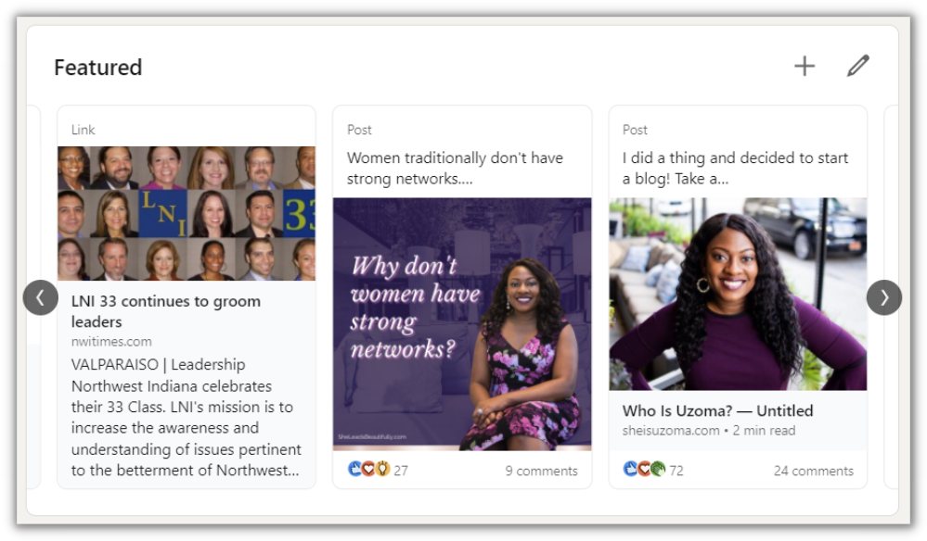
Feautured

Slide 20
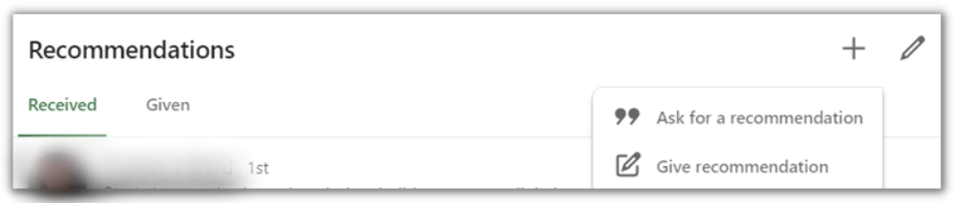
Recommendations

Slide 21

Connections
  Be open to connecting with NLU students, faculty, and staff
  You also have the option to change the default to "Follow"
  "Connect" = 2-way "Follow" = 1-way

Slide 22
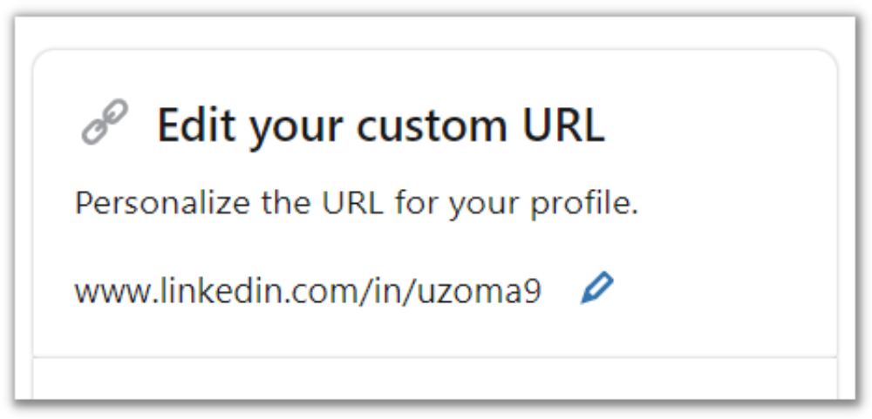
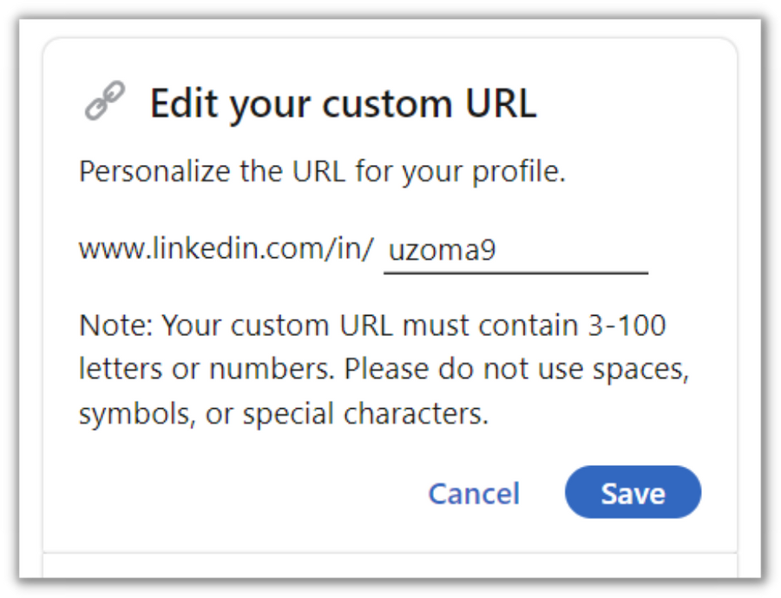
Custom URL
  Makes your profile easier to find and share
  Enhances credibility
  Is an extension of your personal brand

Slide 23
Your Turn!
Customize your LinkedIn URL.

Slide 24

RELATIONSHIP BUILDING

Slide 25

Relationship Building
  Establish rapport with new connections
  Nurture existing relationships

Slide 26

Relationship Building
  Connect and Follow
  Follow NLU, hashtags, thought leaders, and companies
  Send and respond to InMail messages; use voice feature
  Comment on existing posts to engage in conversations

Slide 27
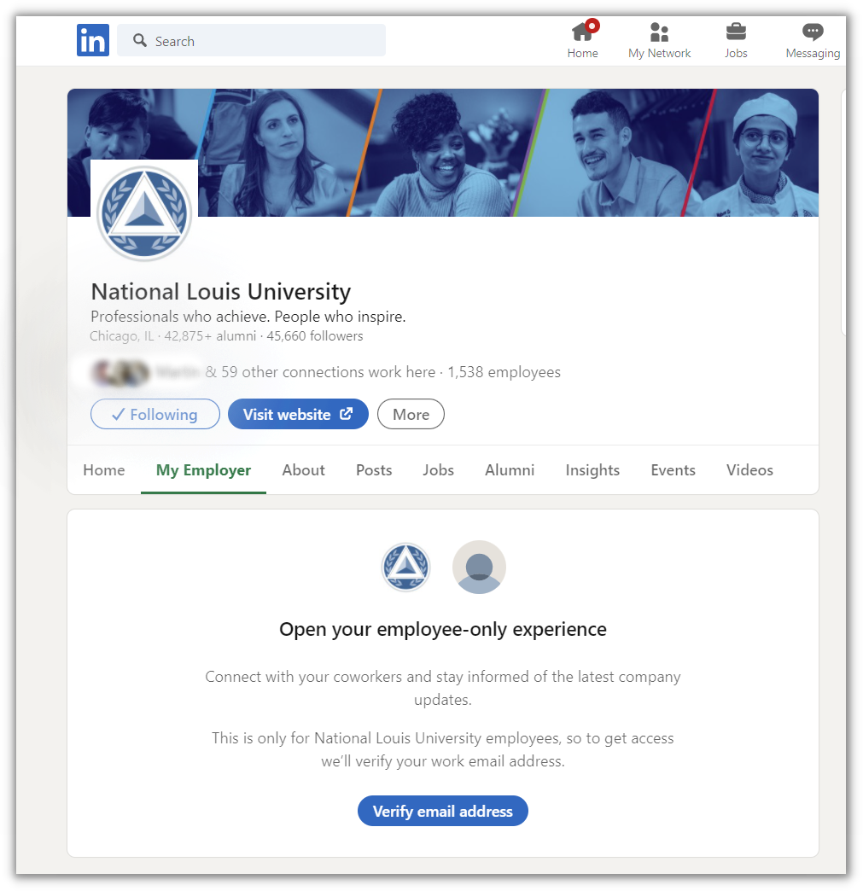
Relationship Building

Slide 28

THOUGHT LEADERSHIP

Slide 29

Thought Leadership
  Showcase your expertise
  Maintain visibility
  Create community and engagement

Slide 30
Thought Leadership
  Share information and resources relevant to your expertise
    News articles
    Original content
  Share resources that may be of interest to students
  Share NLU updates
    Job postings
    Events
  Don't be afraid to share something personal
    Day in the life / Behind the scenes
    Fun facts

Slide 31
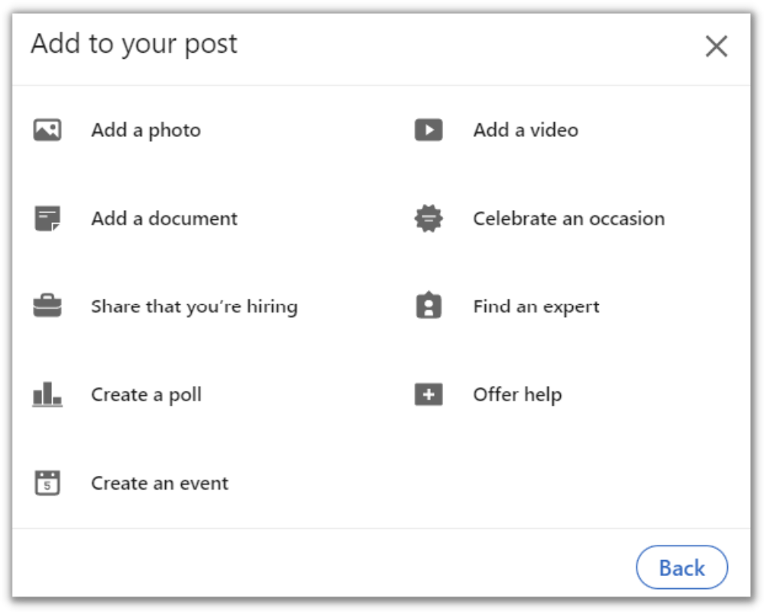
Thought Leadership

Slide 32
LinkedIn Help is your friend!
https://www.linkedin.com/help

Slide 33
In the Chat
What are 2 topics you can begin talking about on LinkedIn to showcase your thought leadership?

Slide 34
Reflection
What is your biggest takeaway from today's session?

Slide 35
Exit Survey
Please take a moment to complete the survey.
Notes:
https://forms.gle/J1gNsqx4MYzBpqRp9

Slide 36
Questions?
Uzoma F. Obidike, M.S.Ed.
Assistant Professor, Career Development
Undergraduate College
uobidike@nl.edu
Let's connect on LinkedIn!
Linkedin.com/in/uzoma9

